Slide 1
Gender EQUALITY
EVERYONE’S BIRTHRIGHT
Notes:
The world has come on a long way since women had no rights at all and were not even allowed to vote.
There has been progress.
BUT…… there is still a long way to go.
“Gender equality is not only a fundamental Human right, but a necessary foundation for a peaceful, prosperous world”
Source: text from UN goal 5

Slide 2
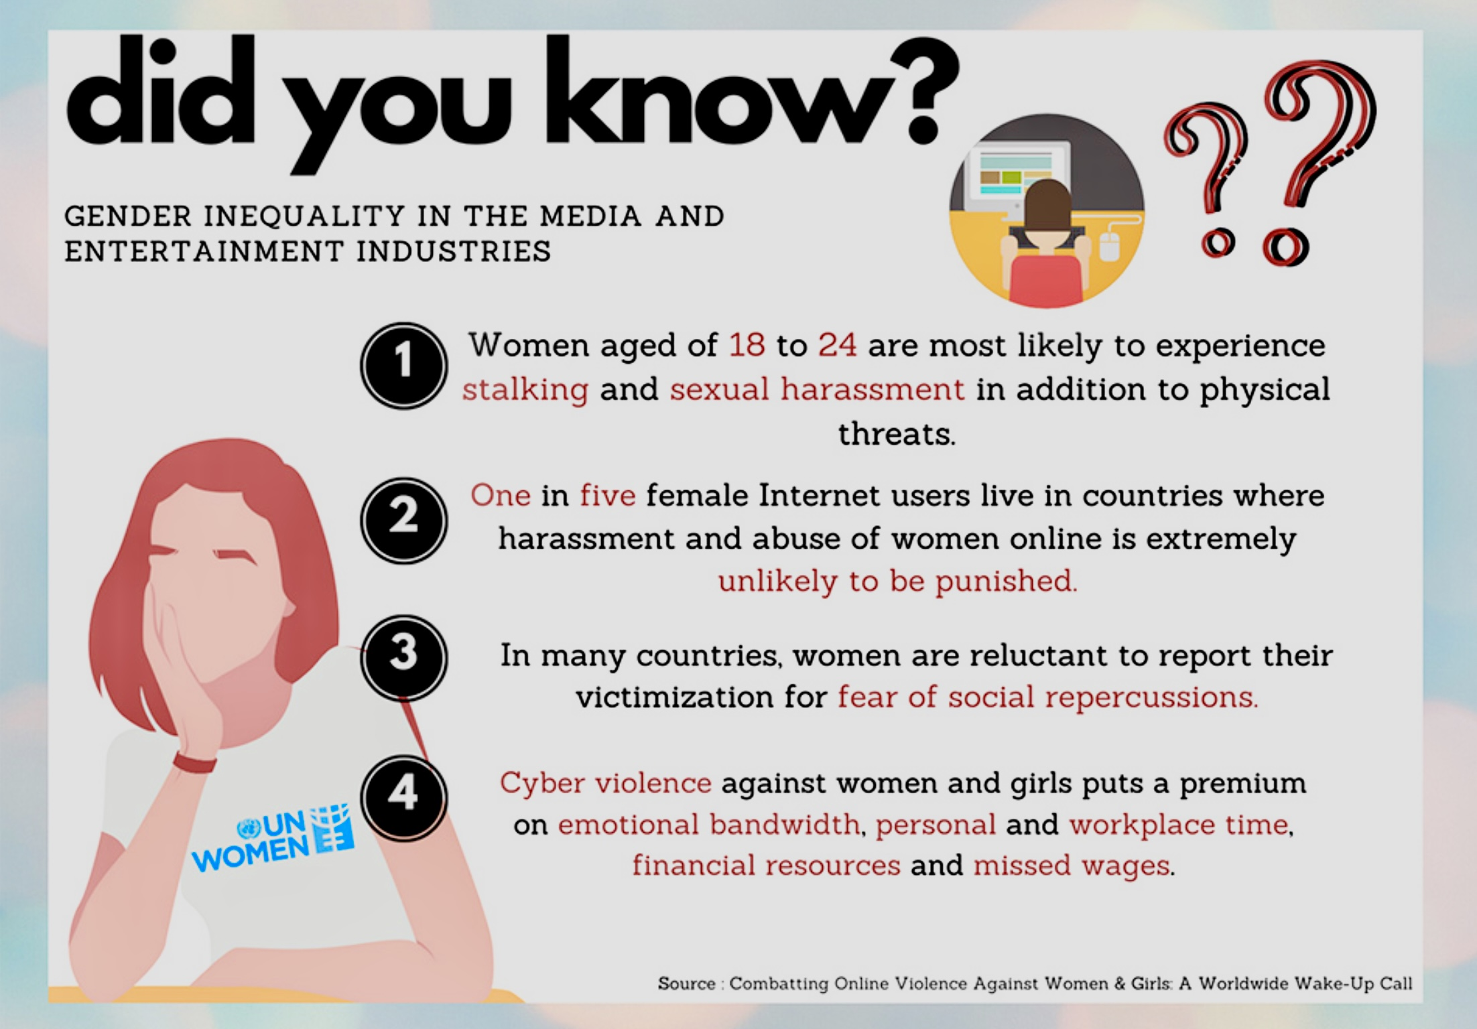

Slide 3
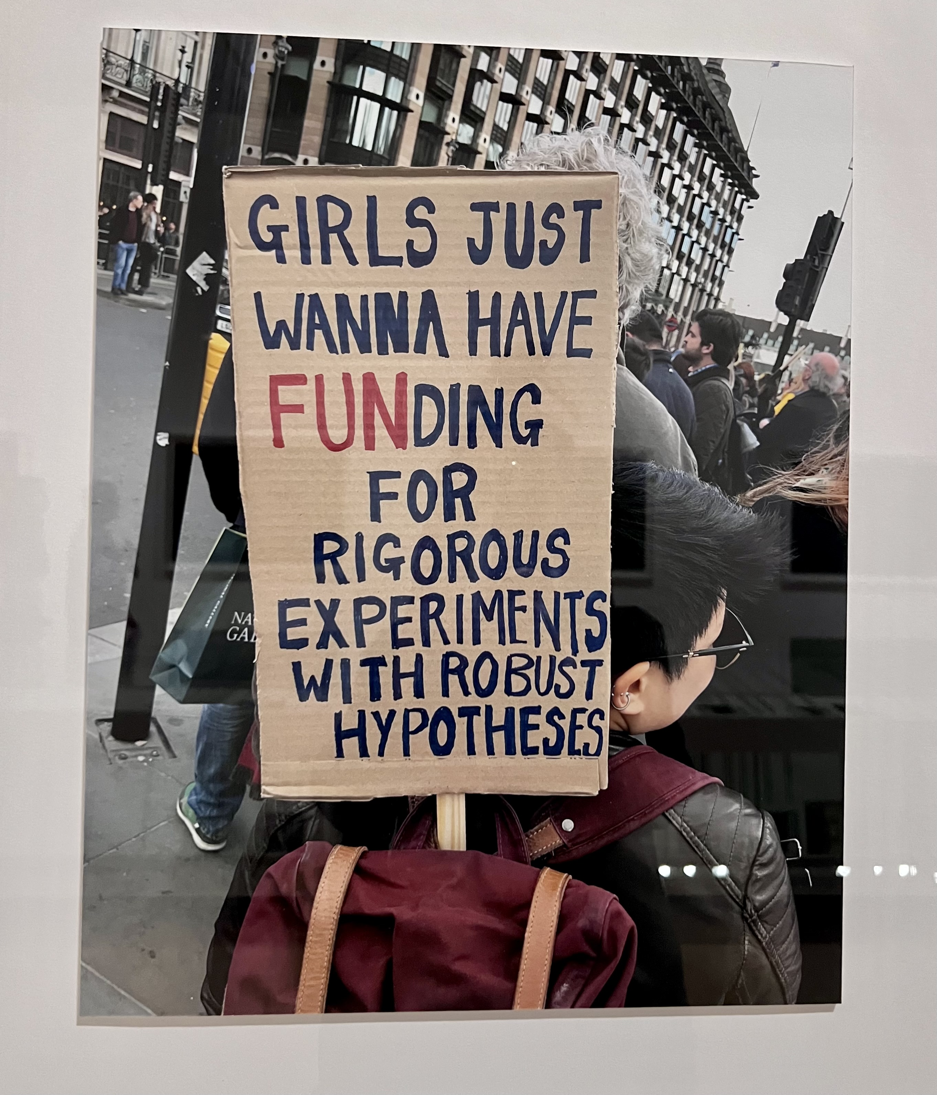
GENDER PAY GAP
Women work 70% of the world’s working hours, yet earn only 10% of the world's income
Women globally are paid about 20 per cent less than men
Notes:
Cornelia Parker photo highlighting women demanding equal status to men on funding for education

Slide 4
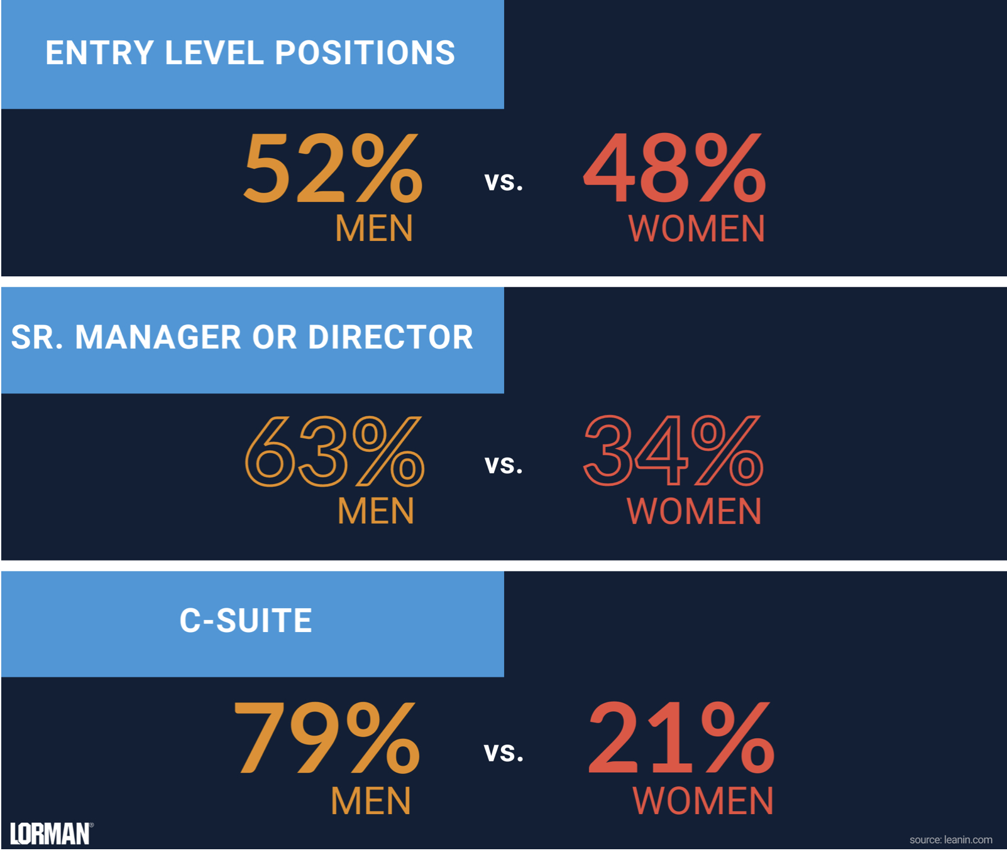
For every 100 men promoted and hired to manager, only 72 women are promoted and hired.

Slide 5
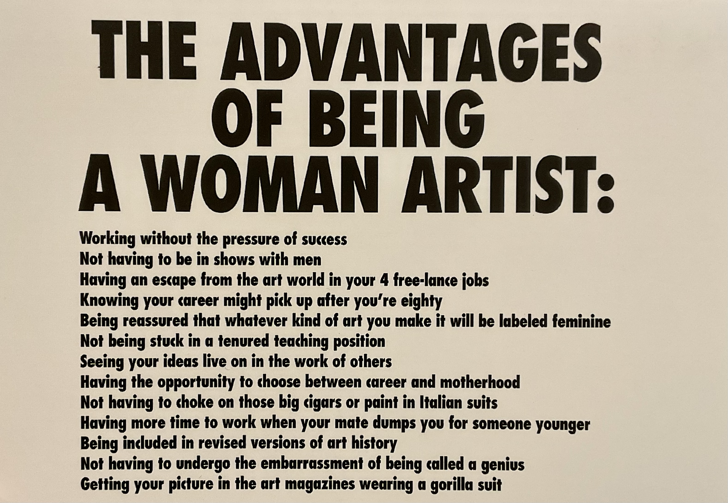
Notes:
Guerilla girls is an anonymous group of feminist artists devoted to fighting sexism and racism within the art world

Slide 6
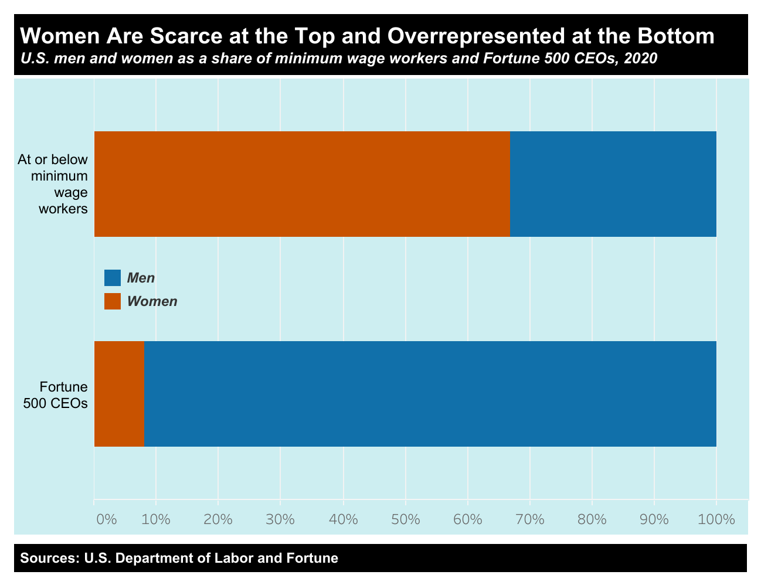

Slide 7
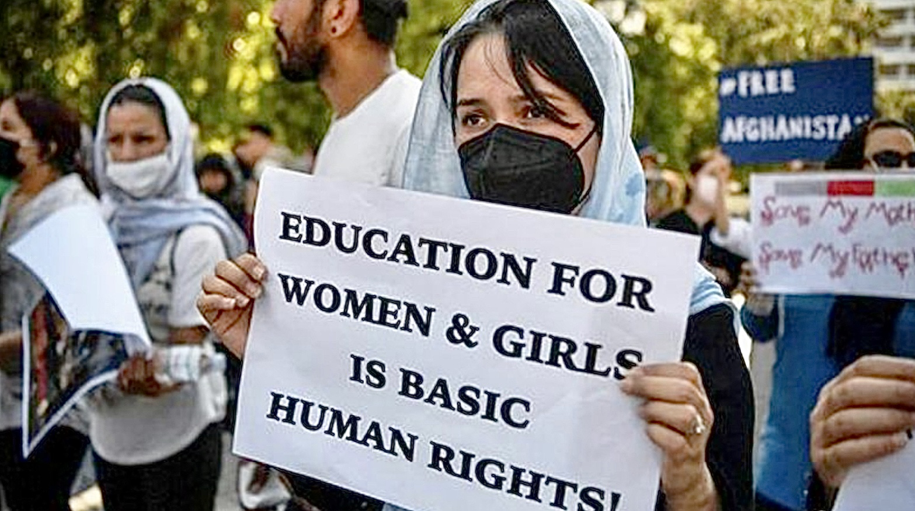
GENDER BIAS IN EDUCATION
Two thirds of the world’s illiterate people are women
Worldwide, 129 million girls are not in school

Slide 8
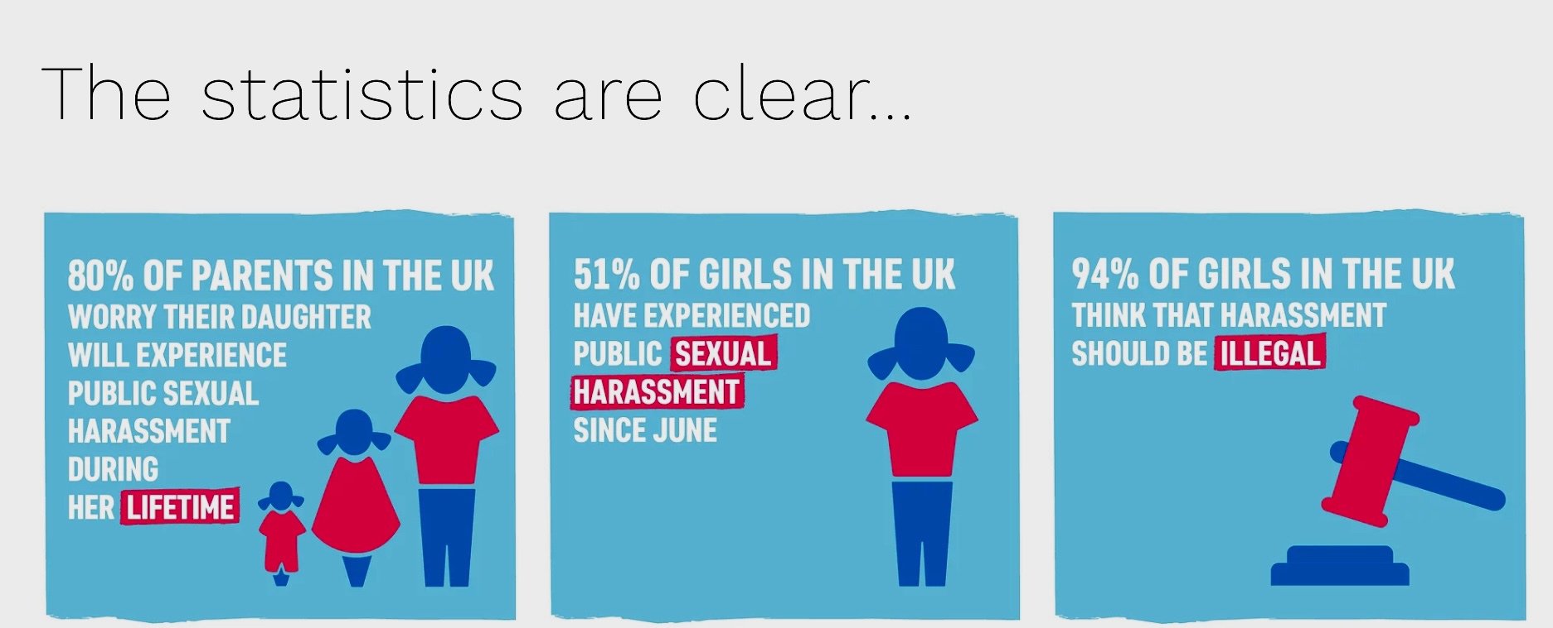
SEXUAL HARASSMENT
Notes:
Still a shocking fact that most women will experience sexual harassment at some time in their lives.

Slide 9
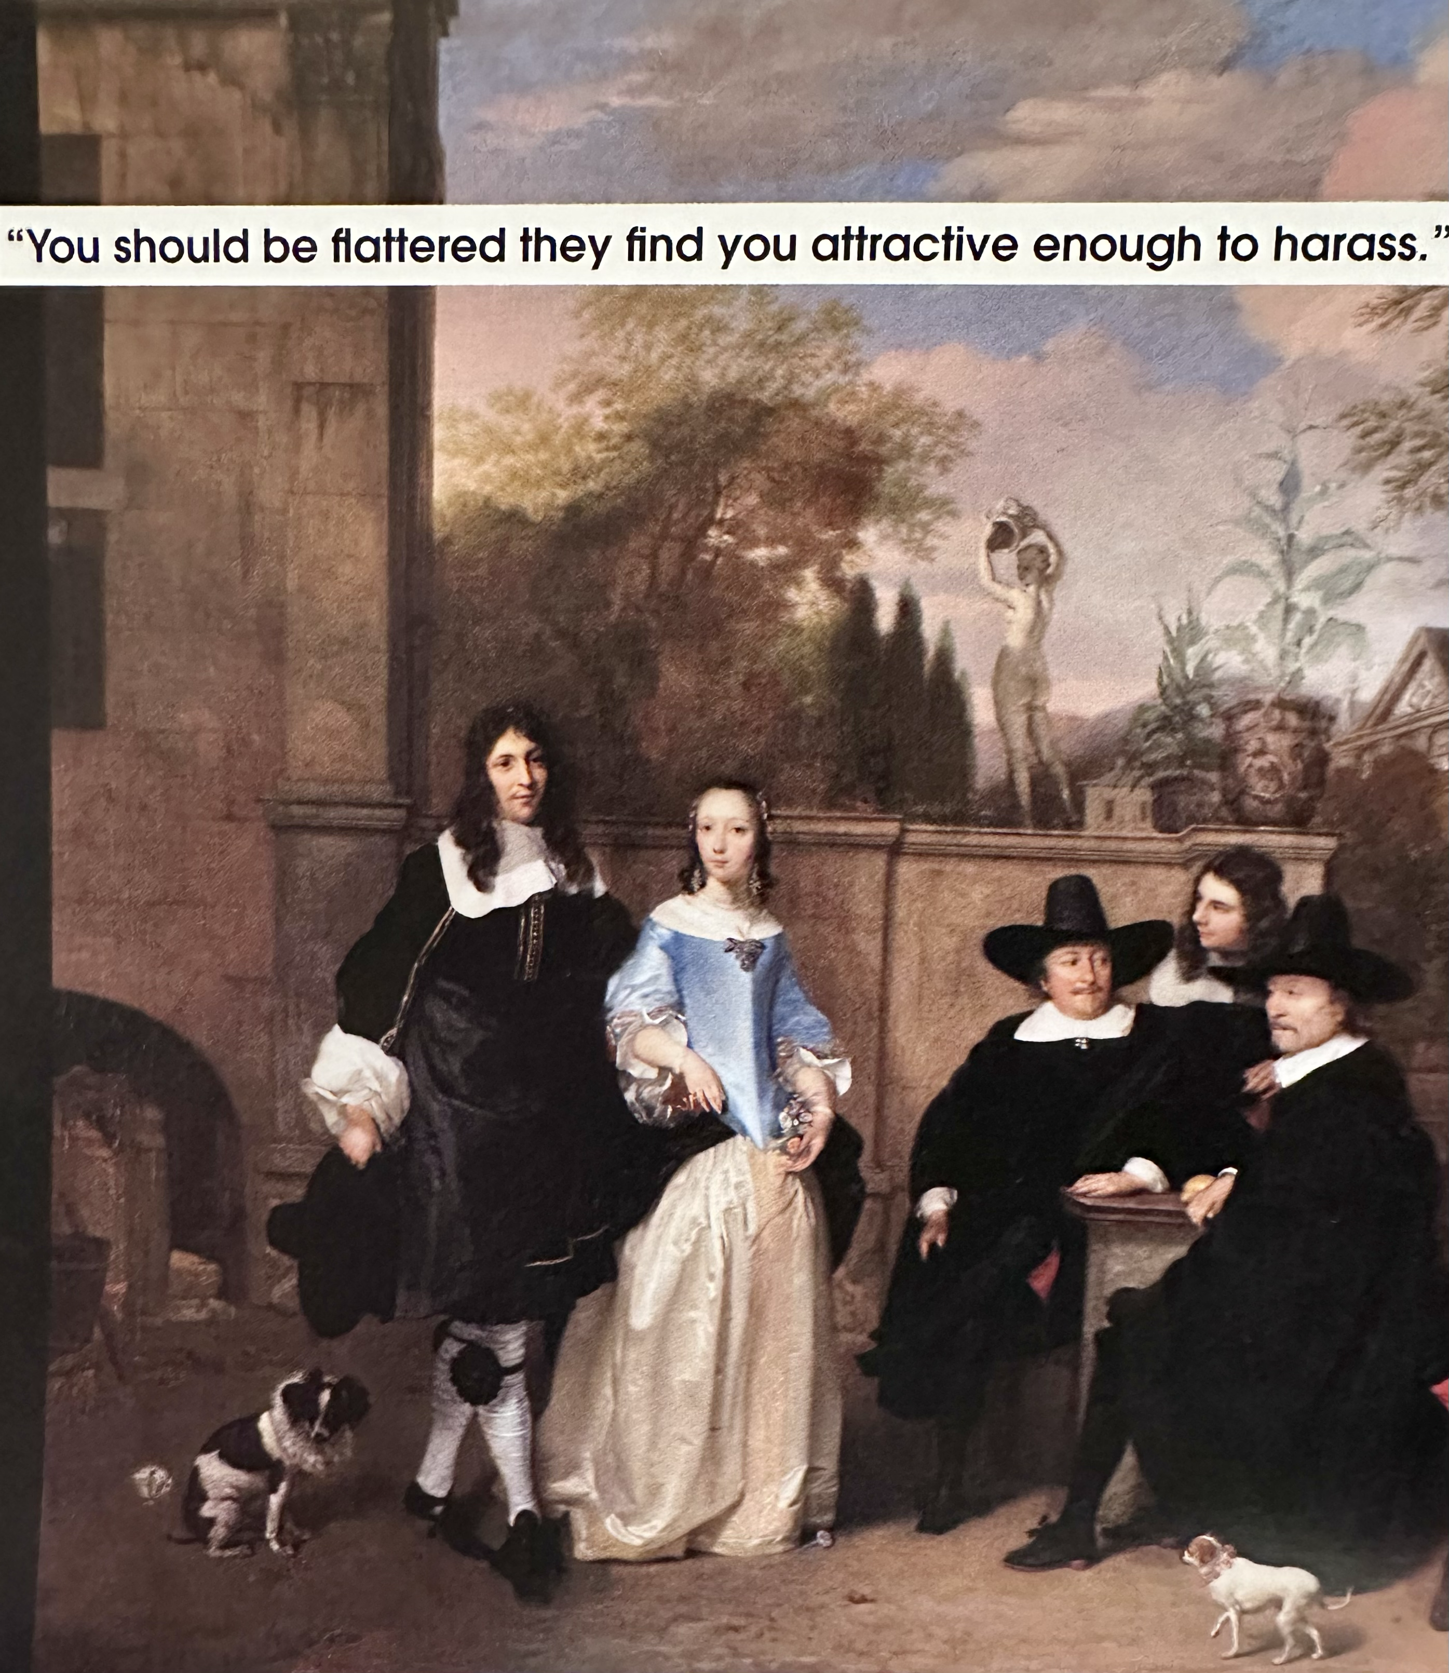
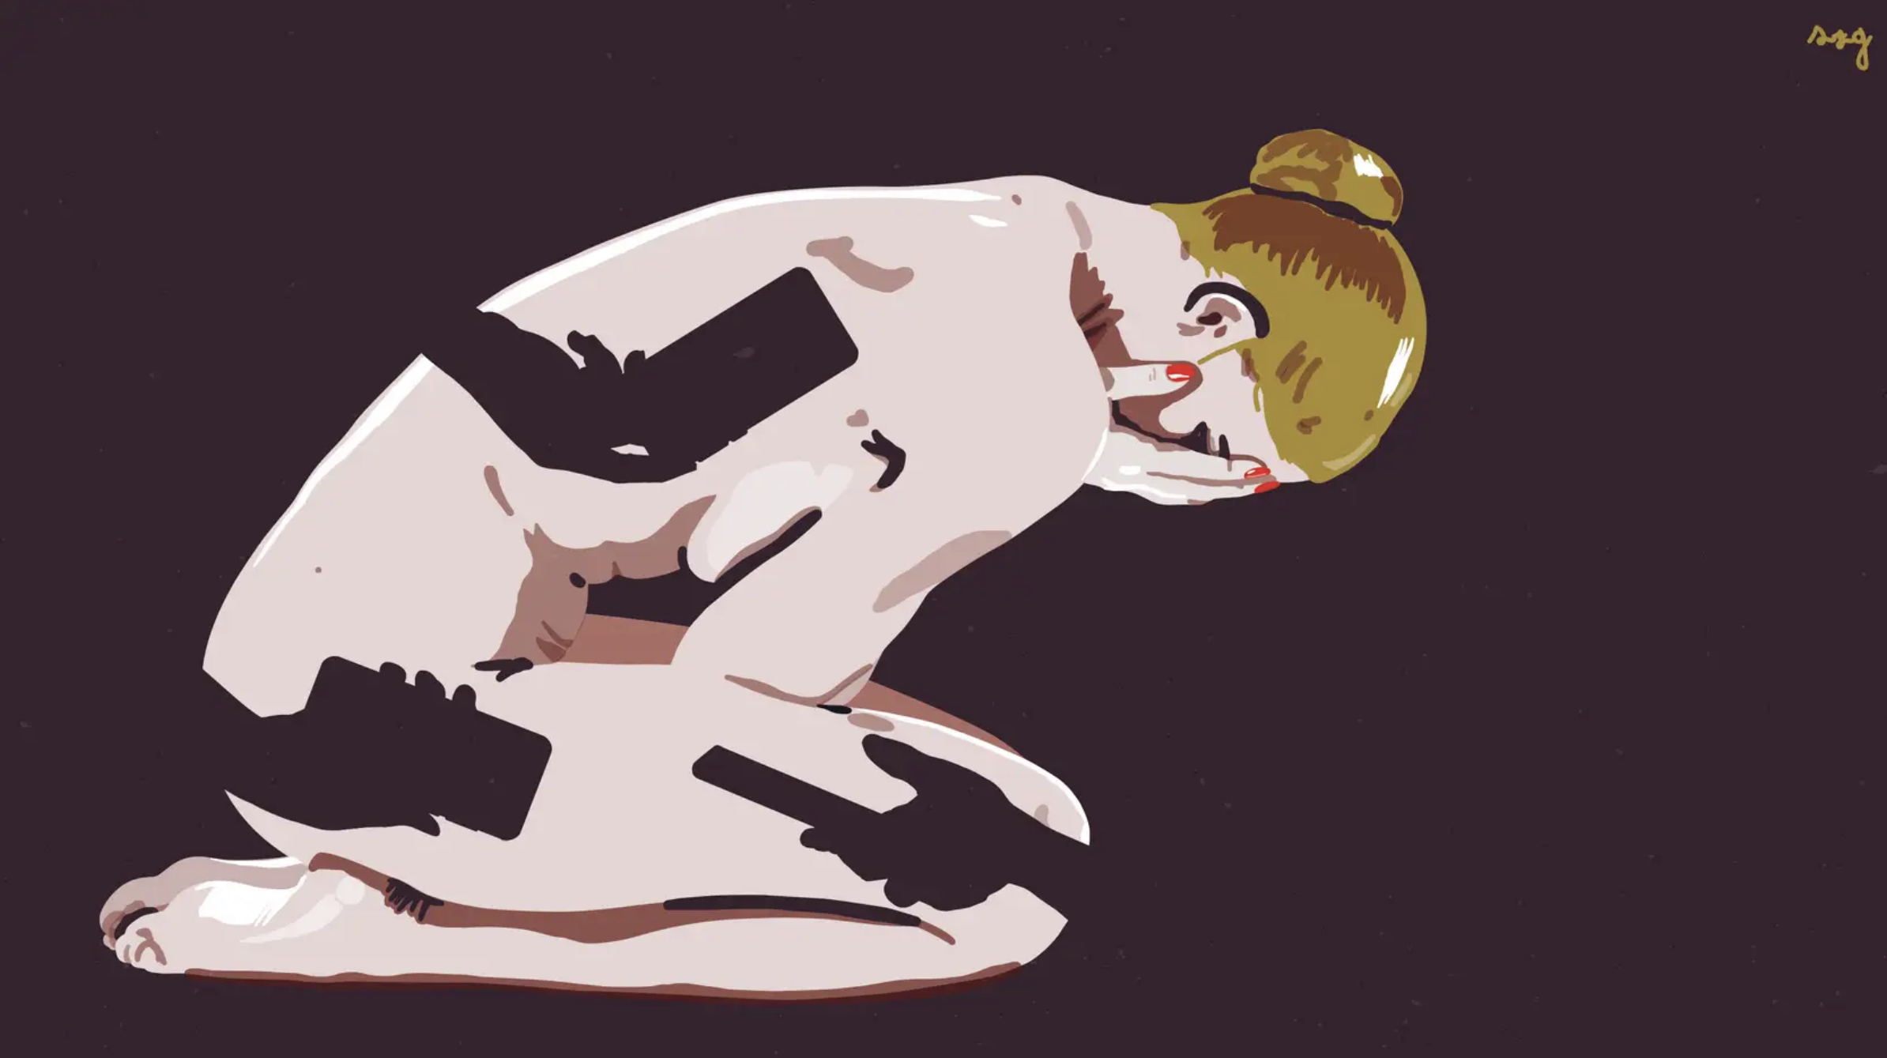
CRIME NOT COMPLIMENT
Notes:
The book “men to avoid in Art and Life” makes a serious point about the extreme inequality that women have always been subjected to by using old master (?) paintings with a amusing tagline
Anonymous illustrator showing how a modern and frightening form of sexual harassment with online and social media is devastating to the victim.
Crime not Compliment is a campaign by Plan International to make all forms of sexual harassment a crime

Slide 10
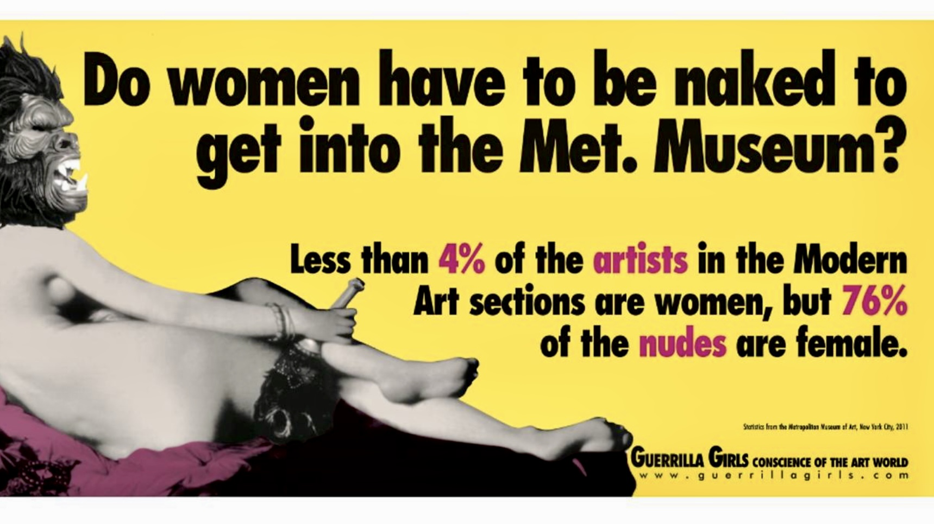
Notes:
Guerilla Girls famous point about the inequality in art world

Slide 11
Female Genital Mutilation
MUST STOP NOW
200 million girls and women alive today living in
31 countries have undergone FGM

Slide 12
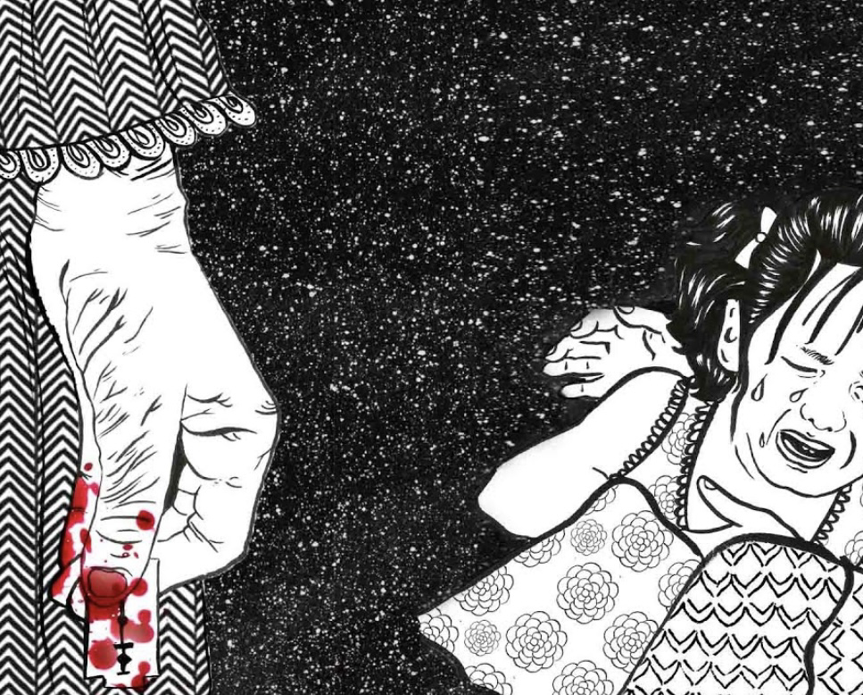
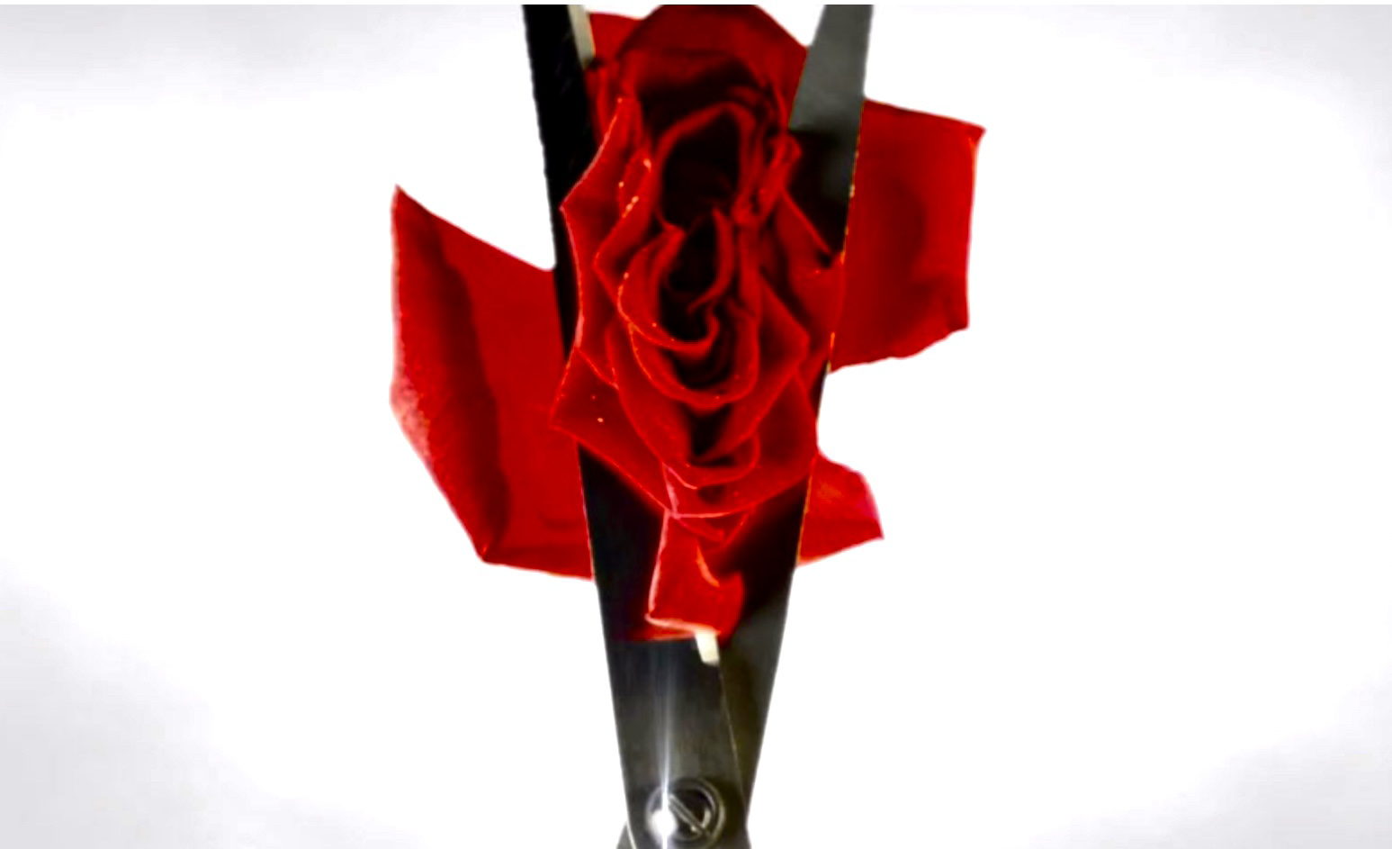
MY BODY; MY RULES HER BODY; NOT YOURS
Notes:
London-based artist Aida Silvestri has created a jarring series of "sculptural photo-works" to raise awareness of female genital mutilation
125 million women and girls bear the scars of FGM.
FGM is often used to control female 'modesty', virginity and sexual behaviour

Slide 13
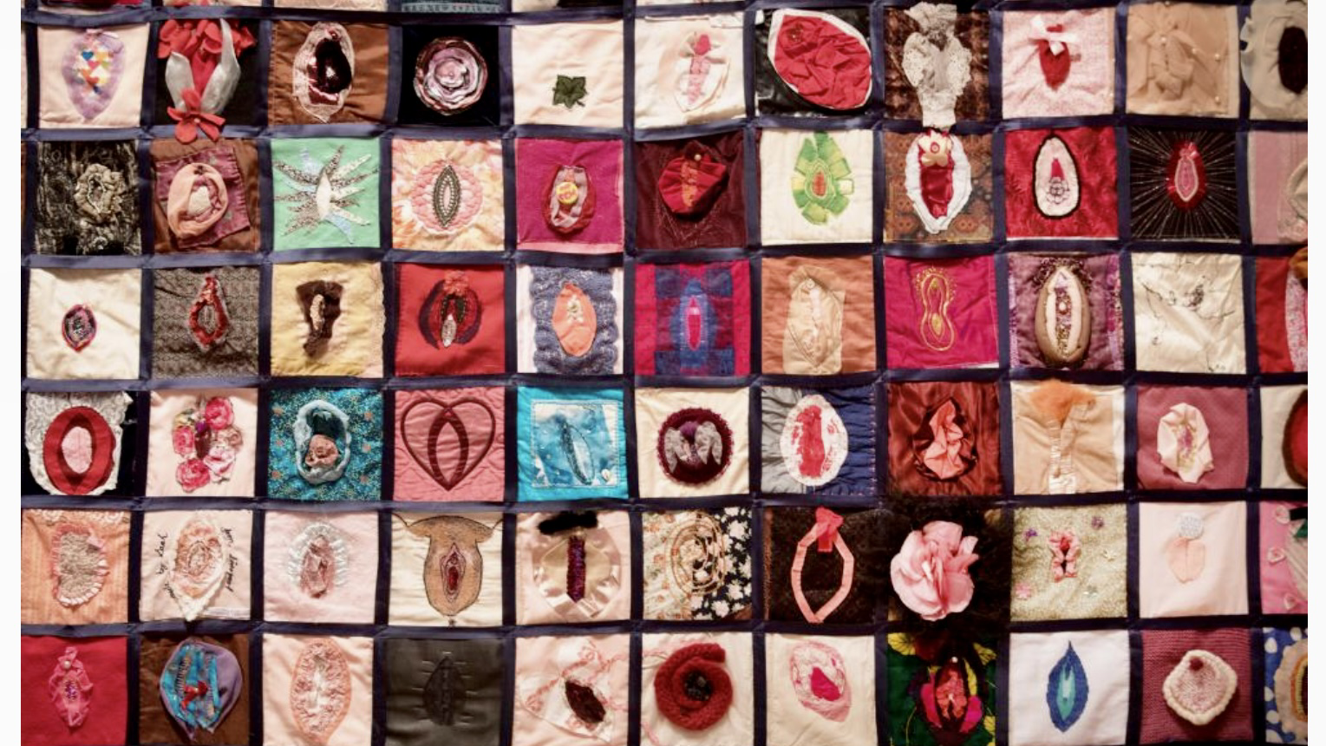
MITTS OFF MY MUFF
Notes:
Shoreditch sisters Vulva Quilt created with help of Womens Institute knitting and sewing
vulva quilt in London.
Shoreditch Sisters WI

Slide 14
NO ACCESS TO SAFE ABORTION
41 percent of women live under restrictive abortion laws.
The inability to access safe and legal abortion care impacts 700 million women.
According to the WHO, 23,000 women die of unsafe abortion each year and tens of thousands more experience significant health complications.
Legal restrictions on abortion do not result in fewer abortions, instead they compel women to risk their lives and health by seeking out unsafe abortion care.

Slide 15
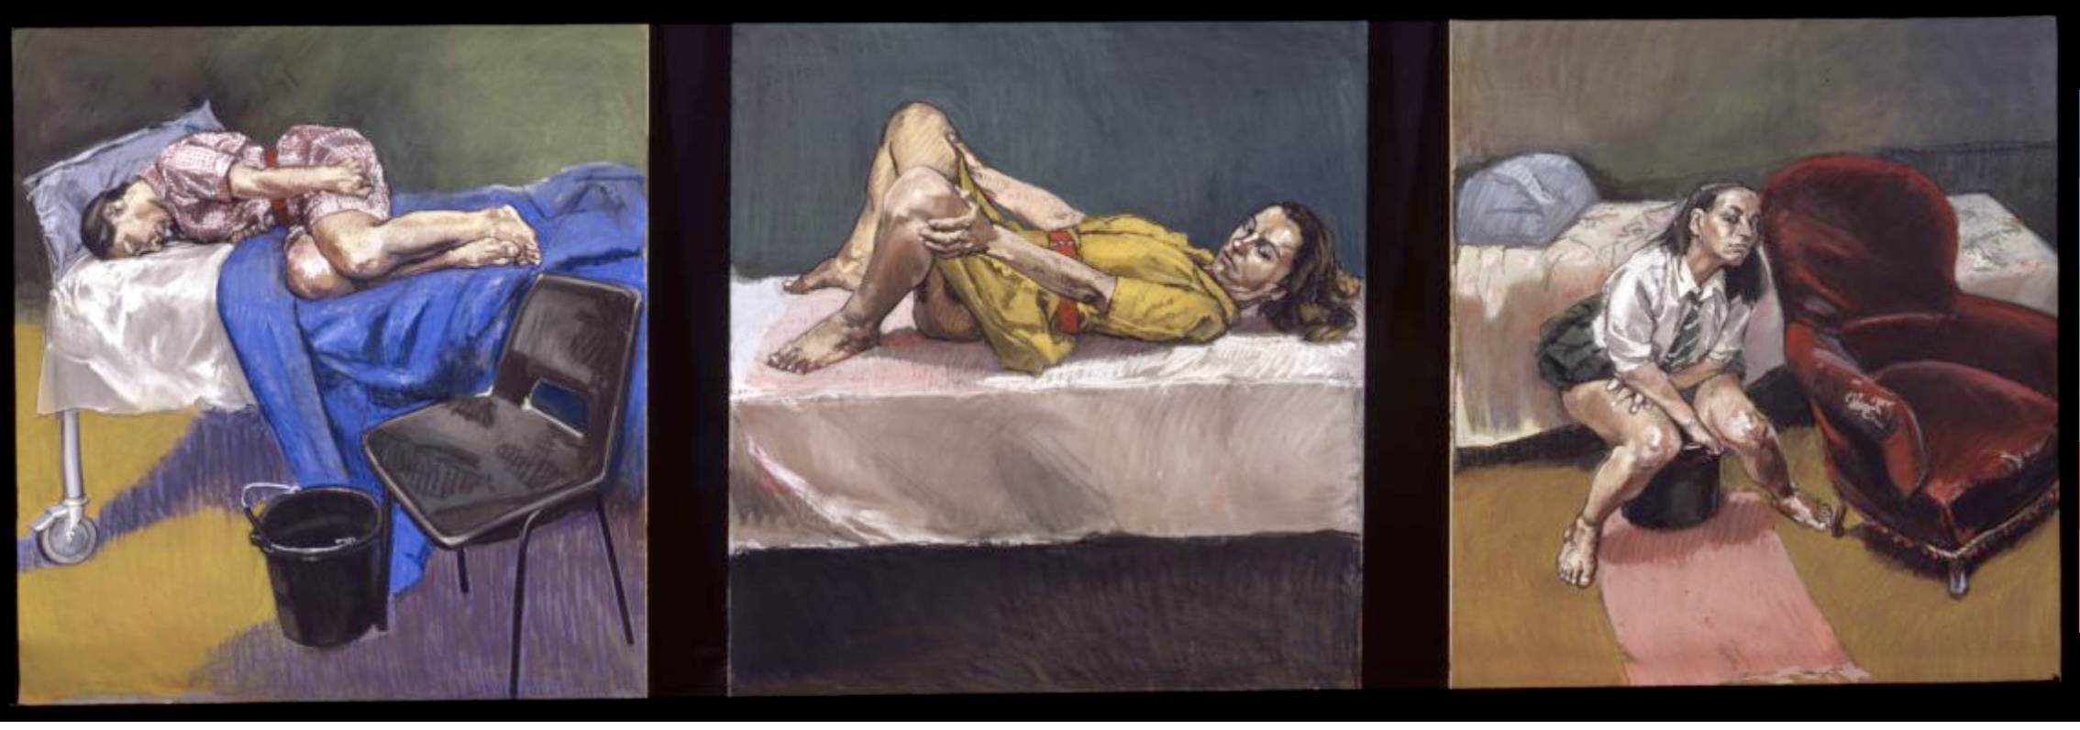
25 million unsafe abortions every year resulting in over 47,000 preventable maternal deaths
Notes:
Paula Rego,
Abortion Pastels. Instrumental in Portugal finally changing abortion law. Used in public campaign before the final vote in favour of making it legal

Slide 16
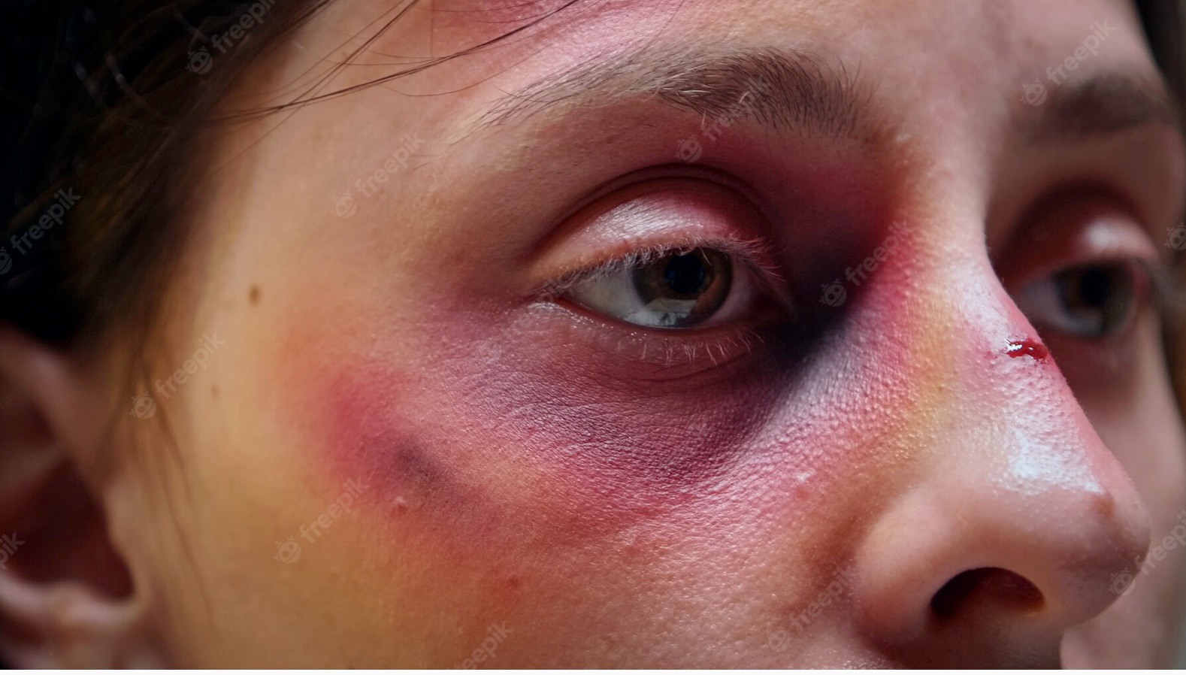
GENDER BASED VIOLENCE

Slide 17
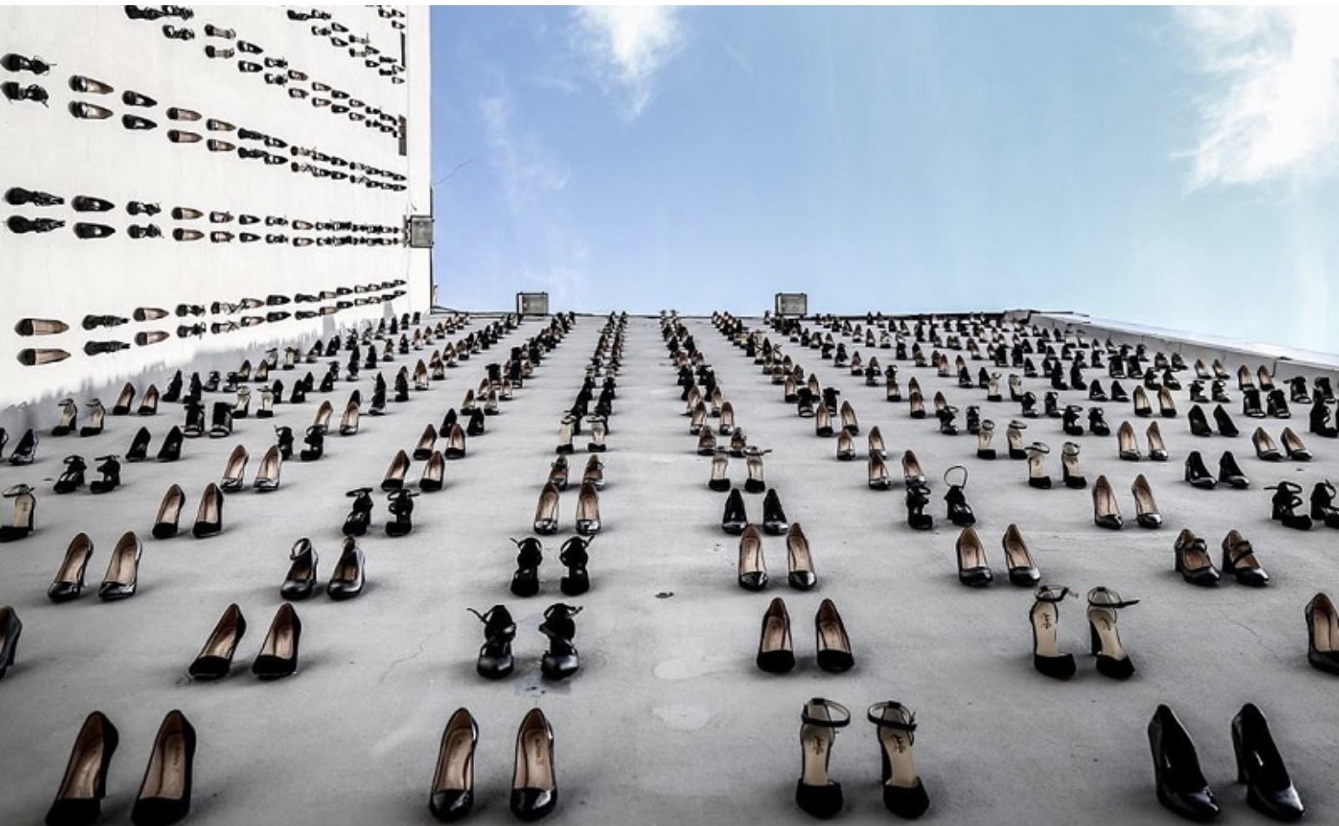
46,000 women murdered in domestic or sexual violence every year. And rising
Notes:
Turkish artist Vahit Tuna has mounted 440 pairs of high heels on the facade of a building on a busy Istanbul street, to symbolize the number of women murdered in domestic or sexual violence in Turkey in 2018.

Slide 18
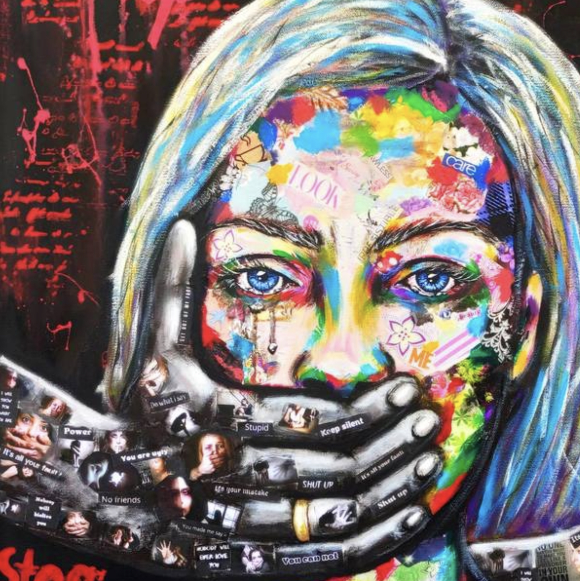
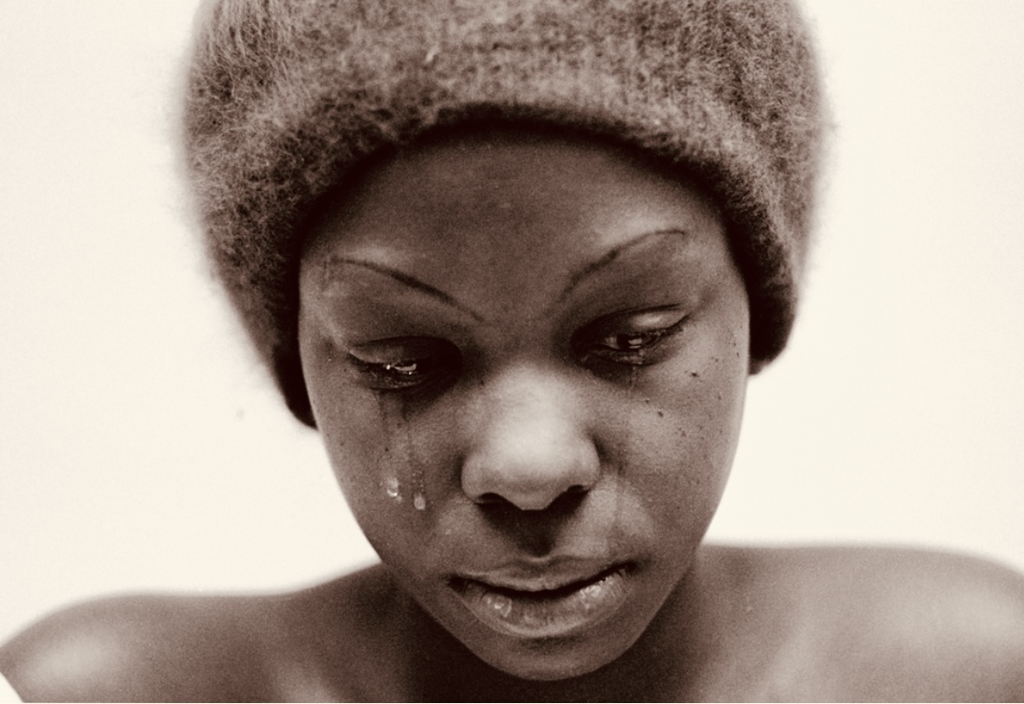
736 million women globally are subjected to physical or sexual violence
Notes:
Grumet creates works that blend digital and traditional painting to portray the troubling consequences of our society’s vices. In Pole Dancers, he transforms a construction site into a strip club, drawing a connection between the adult entertainment industry and the spillover effects of objectification, such as harassment in daily life and discrimination in the workplace.
Pole Dancers
Al Grumet, 2017, digital composite,
1 in 3 women, around 736 million, are subjected to physical or sexual violence by an intimate partner or sexual violence from a non-partner – a number that has remained largely unchanged over the past decade. W.h.o.

Slide 19
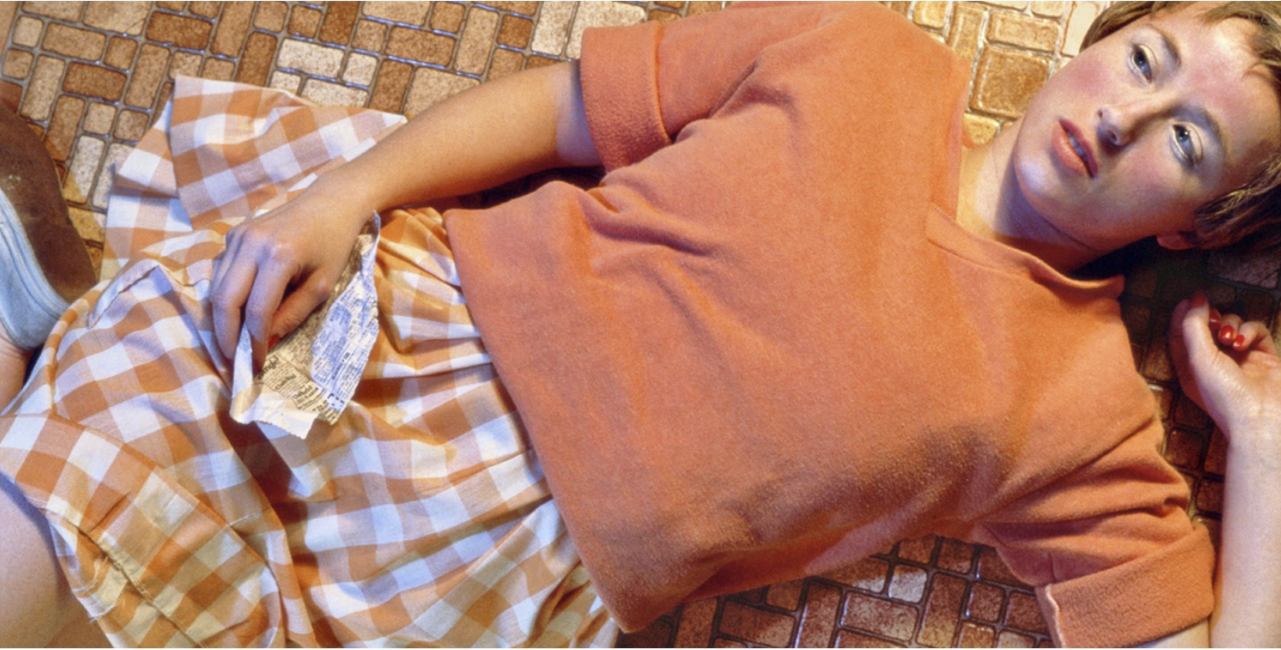
4.8 million global victims of forced sexual exploitation 99% are women and underage girls
Notes:
Untitled #96, 1981 Cindy Sherman
Image inspired by the centre folds of men’s erotic magazines, Sherman appears as the antithesis of what you would expect to find in such a publication. Acting in various emotional states that range from terrified to miserable, she is anything but sexy and seductive. Implications of rape and abuse are present, with the character’s facial expressions desperate and her body language vulnerable. Sherman’s choice to depict the woman as scared as opposed to strong is a chilling look into the actual dangers of reality.
A study from the United Nations’ International Labour Organization estimated 3.8 million adults and 1 million children were victims of forced sexual exploitation in 2016 around the world.

Slide 20
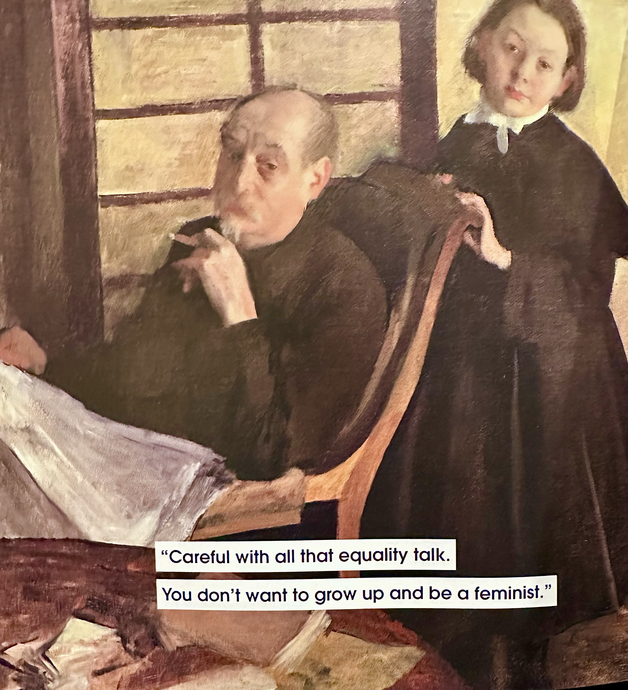
FEMINISM
Advocacy of equality of the sexes and the establishment of the political, social, and economic rights of the female sex

Slide 21
THE END

